Slide 1

Are the Playoffs Different? By: Ben Siglow, Ben Reutelshofer, Nate Cull

Slide 2

Process
Purpose
Data Collection
Exploratory Analysis
Full Comparison
Team Comparison
Draw Backs
Next Steps
Conclusion

Slide 3
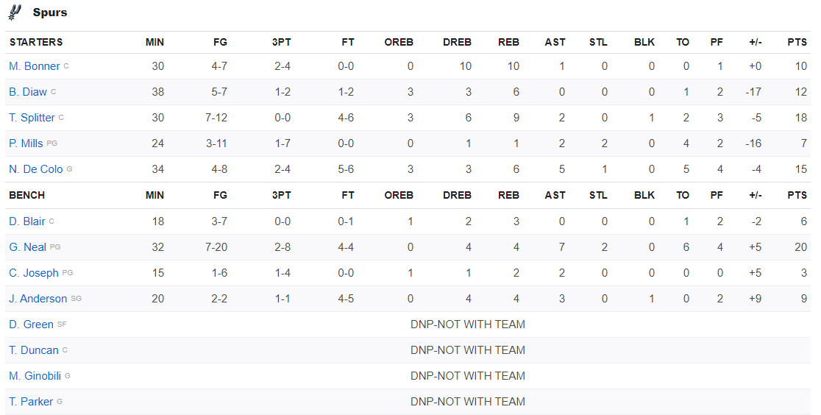

Report: NBA Could Issue Teams of $110K for Resting Players Throughout Season

Slide 4
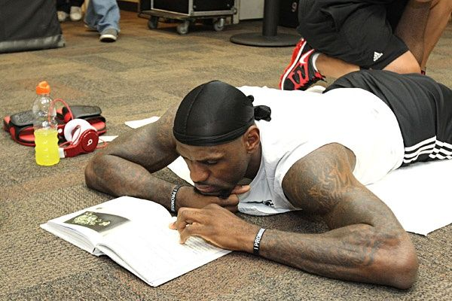
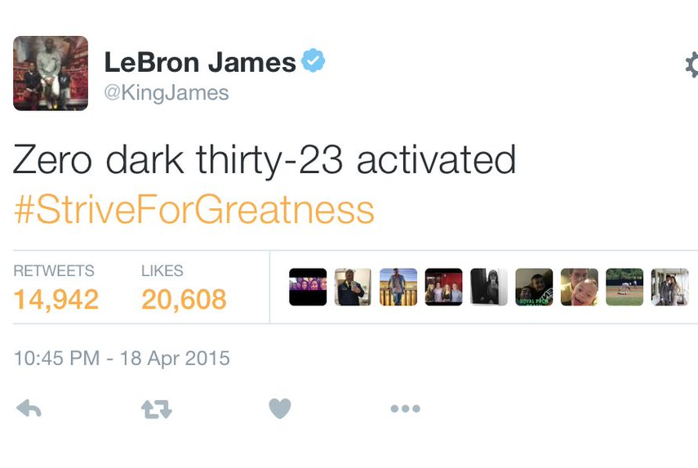
Zero Dark Thirty - 23

Slide 5
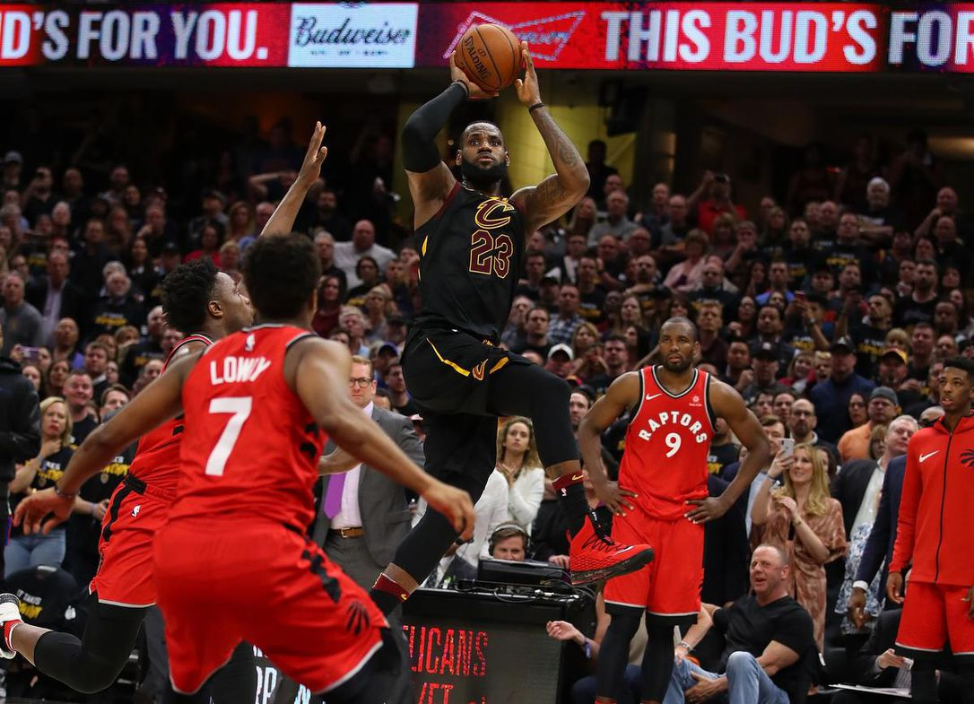
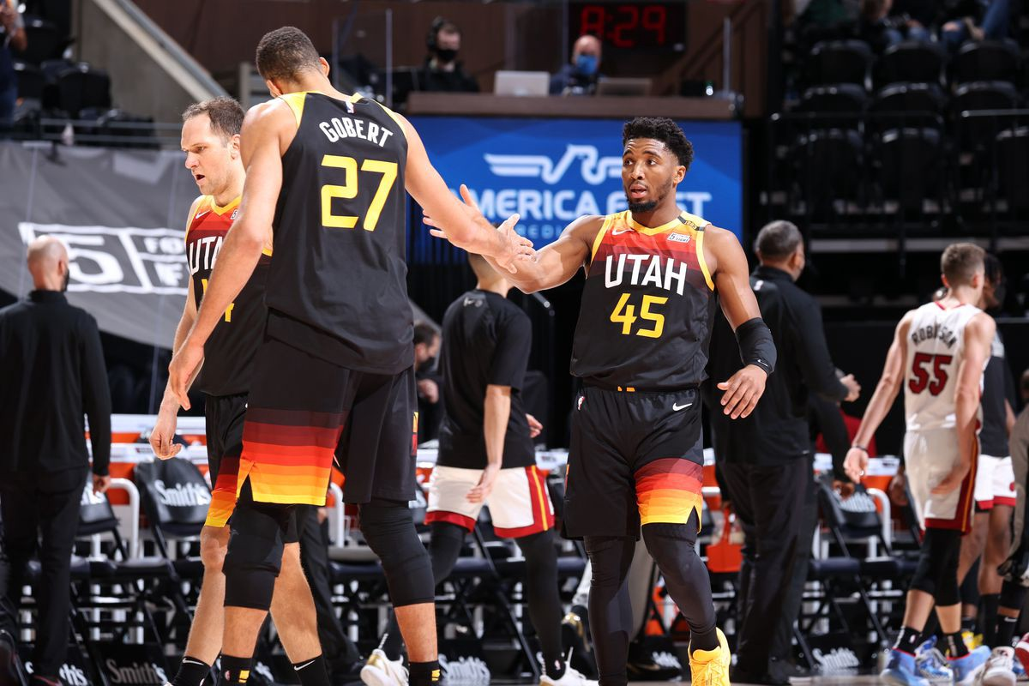
Pretender or Contender?

Slide 6

Data Collection
Data scraped from 2000-2020
Our team data (Basketball Reference)
22 Variables
Over 900 Instances
Opponents Data (Basketball Reference) Defense
22 Variables
Over 900 Instances

Slide 7
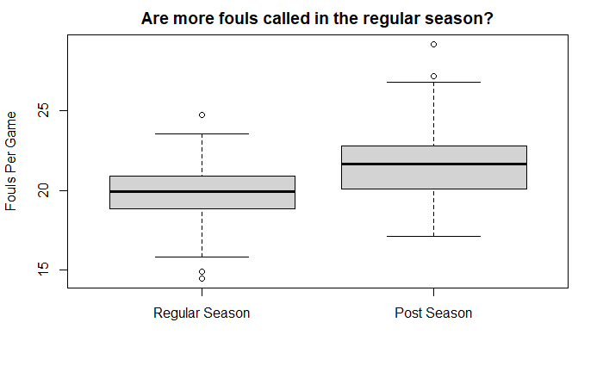
Theory: “Playoff basketball is more physical than regular season basketball”

Slide 8
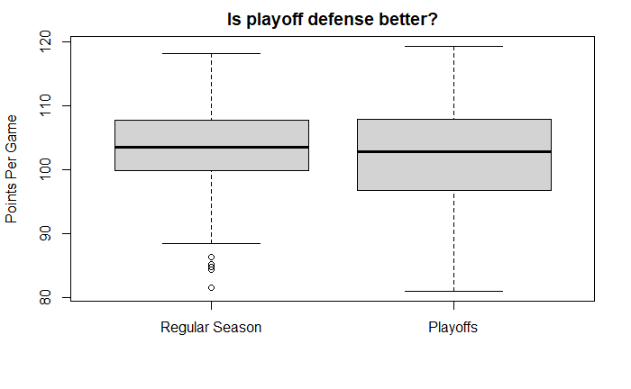
Theory: “It’s much harder to score in the playoffs”

Slide 9
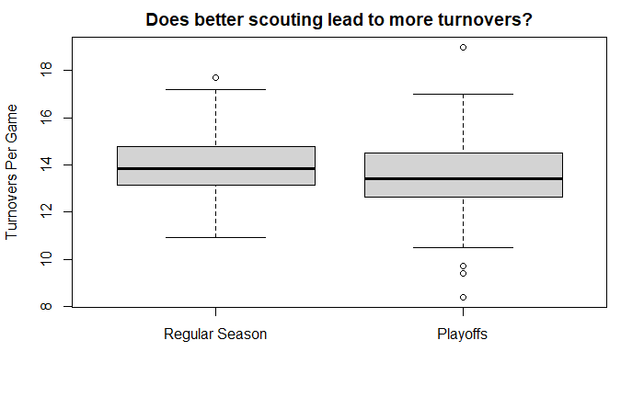
Theory: “Your opponent knows what play is coming”

Slide 10
Hotelling’s T: A measure to compare multiple attributes
Stats we hope to increase
Offense: Negligible to zero
Defense: Negligible to zero
Stats we hope to decrease
Offense: Negligible to zero
Defense: Negligible to zero
Full stat comparison
Offense: Negligible to zero
Defense: Negligible to zero

Slide 11
T-test : Testing each attribute
Resulting non-significant differences
Defense
3 Point Percentage
2 Point Percentage
Free Throw Percentage
Defensive Rebounds
Total Rebounds
Resulting non-significant differences
Offense
Offense: Negligible to zero
Defense: Negligible to zero

Slide 12
Checking the best playoff teams
T-test attribute level scores
For results with significant p-values
Better playoff play based on lower critical value
2 points
Better playoff play based on upper critical value
1 point
Final score
A sum of the two above
Max: 3
Team level Hotelling’s T
Each team's box score set into subgroups
FG
Scoring
Mistakes
For results with significant p-values
Better in all subcategories: 2
Better in one subcategory: 1
Better in no subcategories: 0
Final Score
Sum of all subcategory results

Slide 13

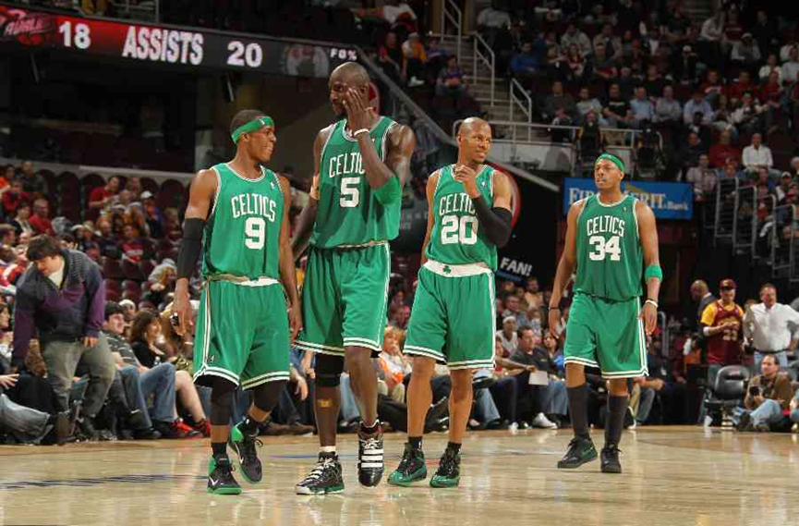
Team Level Offense
T-test Teams
Detroit Pistons
Indiana Pacers
Boston Celtics
Atlanta Hawks
New York Knicks
Hotelling’s T
Boston Celtics
Los Angeles Clippers
Sacramento Kings
Cleveland Cavaliers
Chicago Bulls

Slide 14
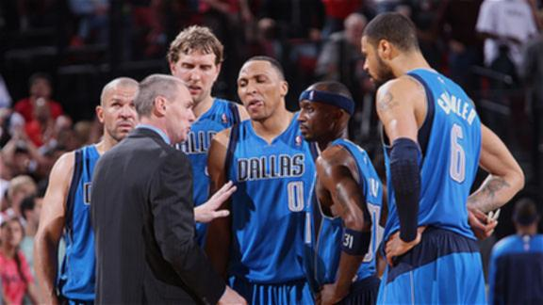
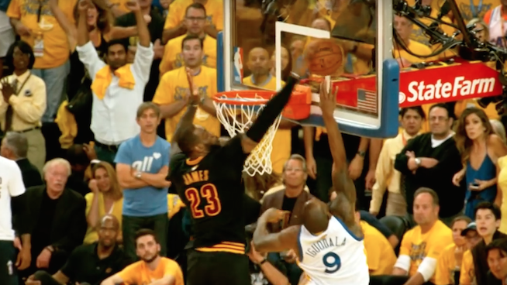
Team Level Defense
T-test Teams
Dallas Mavericks
Portland Trail Blazers
San Antonio Spurs
Los Angeles Lakers
New Orleans Pelicans
Hotelling’s T
Cleveland Cavaliers
Atlanta Hawks
Indiana Pacers
Golden State Warriors
Detroit Pistons
Notes:
Dallas Mavericks
Portland Trail Blazers
San Antonio Spurs
Los Angeles Lakers
New Orleans Pelicans

Slide 15
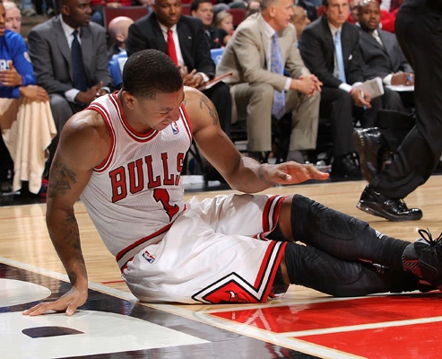
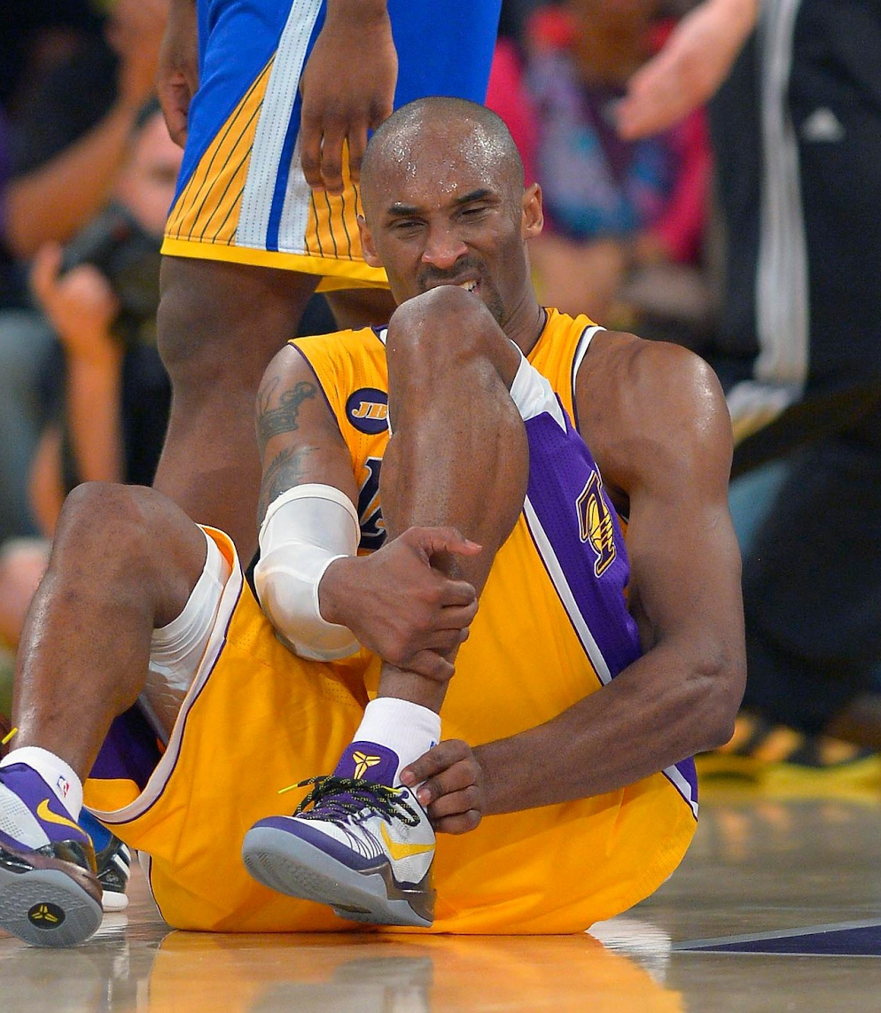
Draw Backs
Skew towards regular season data
We are not accounting for situational issues
Injuries
Hot Streaks
Travel Schedule
Inconsistent teams will have smaller sample sizes

Slide 16

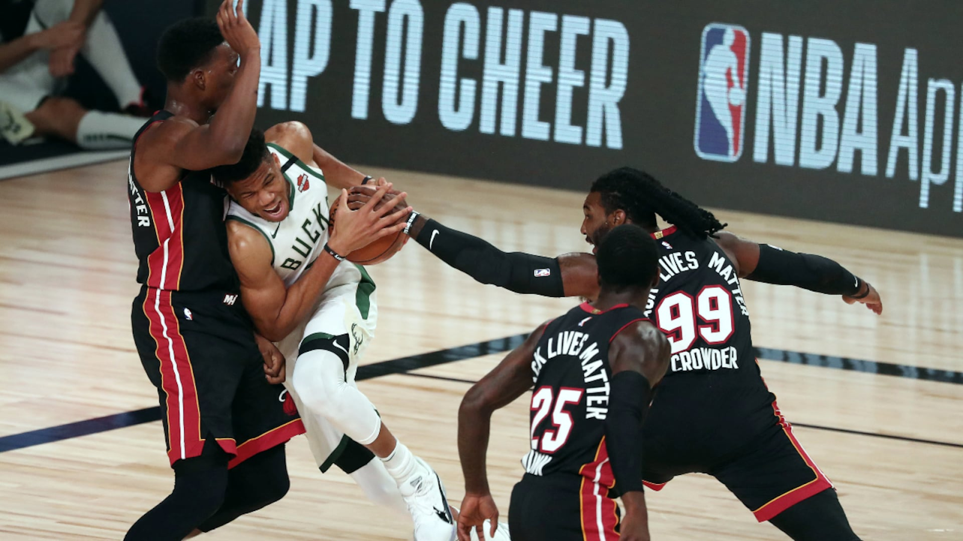
Next Steps
Player Level Research
Weighting different statistics
Look into regressions
Determine how much better something is
More control on team make-up

Slide 17
Conclusion
Playoffs are significantly different than the regular season
The overall stats
Hotelling’s T test
The individual stats
Individual statistic t-tests
Team level statistics
Significant t-tests
Significant Hotelling’s T test

Slide 18

Questions?

